Slide 1

Capstone Project-1
Play Store App Review Analysis
By
Vinayaka R Kulkarni
Prajwal Singh
Jyanathi Challagunda
Samarth Kushwaha
Data Science Trainee, AlmaBetter

Slide 2






WHY ANALYZE THE GOOGLE PLAY STORE?
Mobile App Market is set to grow 20% by 2023
Android Apps comprise 90% of the Mobile App Market
What makes an App popular? Can we predict how popular it’s going to be?
What are some interesting patterns in user behavior related to app usage & feedback?

Slide 3

Introduction
Android is the most popular operating system in the world, with over 2.5 billion active users spanning over 190 countries.
There are more than 3.04 million apps found on Google Play Store.
Actionable insights can be drawn for developers to work on and capture the Android market. The main goal of our project is-
The purpose of our project is to gather and analyze detailed information on apps in the Google Play Store in order to provide insights on app features and the current state of the Android app market.
The Objective of the project to Explore and analyze the data to discover key factors responsible for app engagement and success.

Slide 4

Problem Statement
Problem Statement
Two datasets are provided, one with Google play store data set and the other with user reviews data set for the respective app.
We must examine and evaluate the data in both datasets in order to identify the important characteristics that inﬂuence app engagement and success.
So, what factors inﬂuence an app's success?
An app is said to be successful if it has:
When it has most number of installs and ratings.
Which category apps are most installed.
What is the percentage of installing free apps versus paid apps
What are all the top categories apps.

Slide 5


Agenda
Introduction
Category wise play store apps installs
Category wise most popular apps
Top 20 apps in play store considering all the parameters
Average installs, category wise
Most installed apps in communication category
Average sizes of apps in each category
Category wise percentage of paid apps
Category wise top installed paid apps
Category wise installed apps with content rating
Percentage reviews sentiment distribution

Slide 6

Dataset Preparation
Loading the data sets: Two datasets, First Play store app
dataset and User Reviews dataset.
Import Libraries: NumPy, Pandas, Seaborn and Matplotlib
Data cleaning: Null values, Finding and removing Outliers, Removing duplicate data.
Data Imputation: Filling the missing categorical values with mode and numerical values with median. Conversion of price, installs, reviews into numerical values.
Exploratory Data Analysis: Analyzing the data sets to summarize their main characteristics using statistical graphics and data visualizations method.

Slide 7
1.App : This column Contains the name of the app for each observation. 2.Category : This column Contains Category to which the app belongs. 3.Rating: This column contains the average rating for the app. 4.Reviews : This column contains the number of reviews that the app has received on the play store. 5.Size: This column contains the amount of memory the app occupies on the device. 6.Installs: This column contains the number of times that the app has been downloaded and installed from the play store. 7.Type: This column contains the information whether the app is free or paid. 8.Genres: This column contains the data about to which genre the app belongs. Genres can be considered as a further division of the group of Category. 9.Last Updated: Contains the date on which the latest update of the app was released. 10.Current Version: Contains information on the current version of the app available on the play store. 11.Android Version: Contains information about the android versions on which the app is supported.
Attributes in Google Play store Data

Slide 8

Attributes in User reviews
App- Application name
Translated Review- User review
Sentiment- Positive/Negative/Neutral
Sentiment Polarity- Sentiment polarity score
Sentiment Subjectivity- Sentiment subjectivity score

Slide 9



OVERVIEW OF ANALYSIS
Data Cleaning
Data Exploration
Understand the structure of the dataset and clean data before analysis
Uncover initial patterns, characteristics, and points of interest using visual exploration

Slide 10
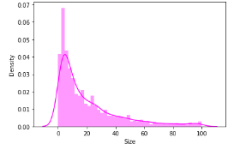
Distribution of App size
The below curve represents the variation of the size of apps available on Google Play store.
It is clear from the visualizations that the data in the Size column is skewed towards the right.
Also, we see that a vast majority of the entries in this column are of the value Varies with device, replacing this with any central tendency value (mean or median) may give incorrect visualizations and results. Hence these values are left as it is.

Slide 11
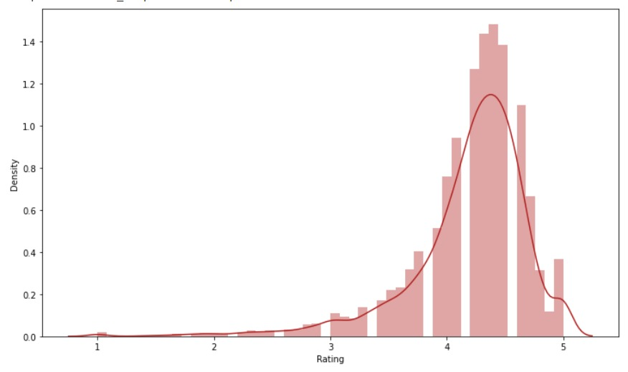
Distribution on Ratings
The mean of the average ratings (excluding the NaN values) comes to be 4.2.
• The median of the entries (excluding the NaN values) in the 'Rating' column comes to be 4.3. From this we can say that 50% of the apps have an average rating of above 4.3, and the rest below 4.3.
• From the distplot visualizations, it is clear that the ratings are left skewed.
• We know that if the variable is skewed, the mean is biased by the values at the far end of the distribution. Therefore, the median is a better representation of the majority of the values in the variable.

Slide 12
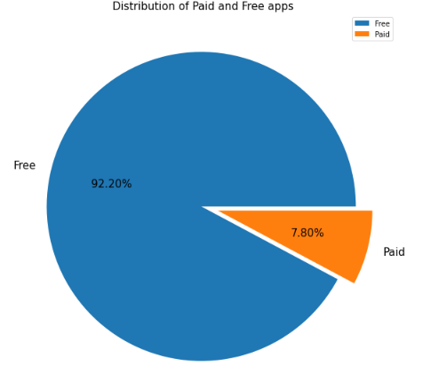

Percentage of Paid apps v/s Free apps
We can Observed from this Pie-chart is that 92.20% of Apps are free and only 7.80% of Apps are paid in Play store.

Slide 13
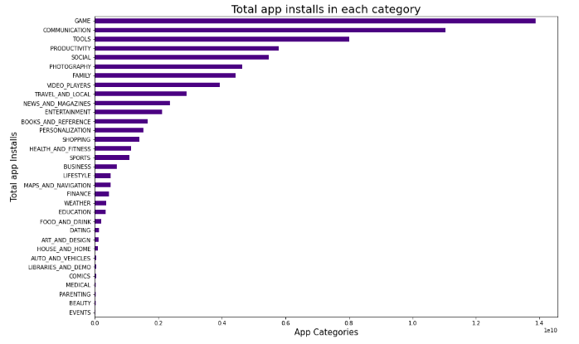
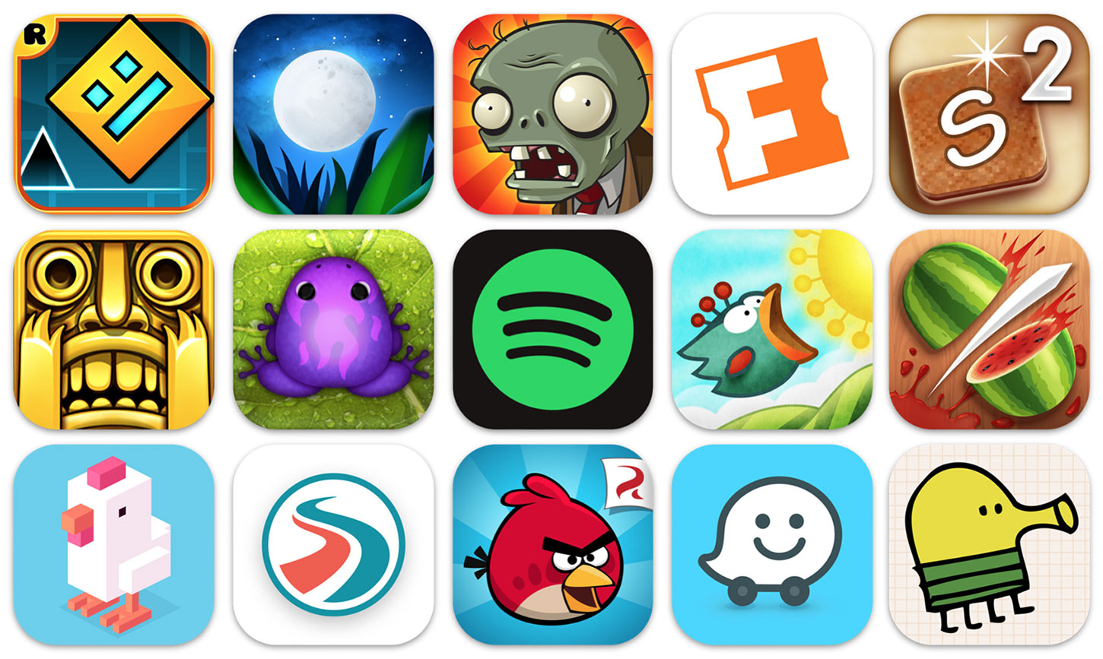
Category App's have most and least number of installs
According to the Graph, we can say that Game is the category which has the most number of Downloads and installations. And the least installed category is Events.

Slide 14
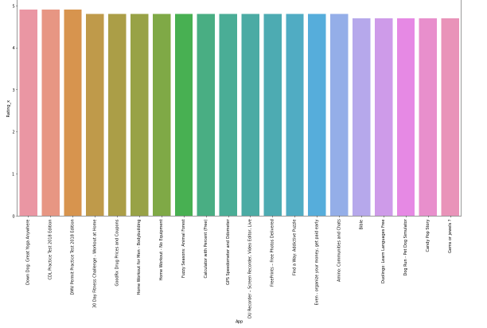
Top 20 most popular apps based on Rating
We can see that all of the top 20 apps are rated close to 5 stars. We can say the popularity of an app can be determined by higher ratings.
Top 3 Apps in terms of ratings are- Down Dog: Great Yoga Anywhere, CDL practice test 2018 Edition, DMV Permit practice.

Slide 15
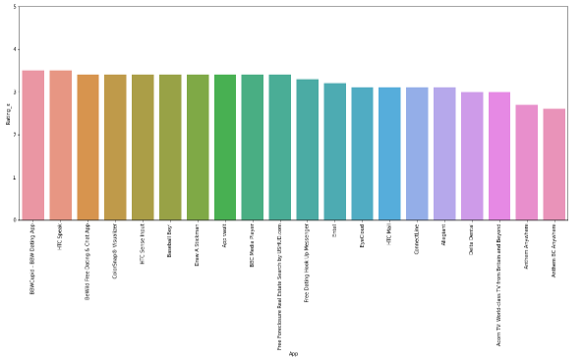
Top 20 least popular apps based on Ratings
Lowest 3 apps in terms of rating are -- Anthem Anywhere, Anthem BC Anywhere.

Slide 16
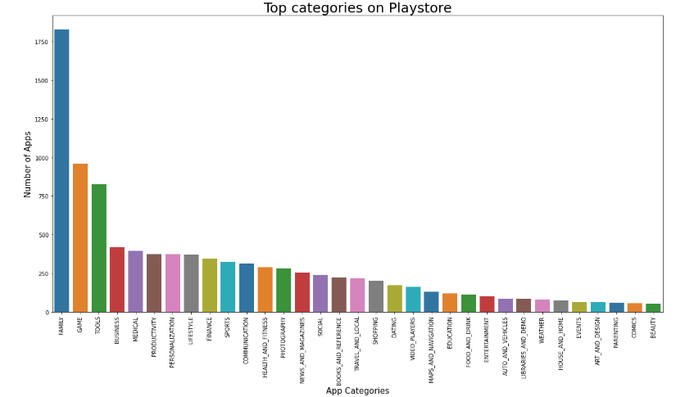
Top Categories on Play store
There are a total of 33 categories in the dataset from the above output we can come to a conclusion that in play store most of the apps are under FAMILY & GAME category and least are of EVENTS & BEAUTY Category.

Slide 17

Challenges Faced
Challenges Faced
Reading the dataset and comprehending the problem statement.
Examining the business KPIs for app development and devising a solution to the problem.
Handling the error, duplicate and NaN values in the dataset.
Designing multiple visualizations to summarize the information in the dataset and successfully communicate the results and trends to the reader.

Slide 18
Conclusion’s
Family, Game and Tools are top three categories having most number of Downloads.
Most competitive category: Family.
92.19% apps are Free and 7.81% apps are paid in type.
81.80% apps have Everyone content rating.
Category with the highest number of installs: Game
Most of the apps (around 50%) have an average rating of 4.3; The rest of the apps are below 4.3.
Most of the apps are under the size of 50 MB.
The median size of the apps in the play store is 12 MB

Slide 19


